Slide 1
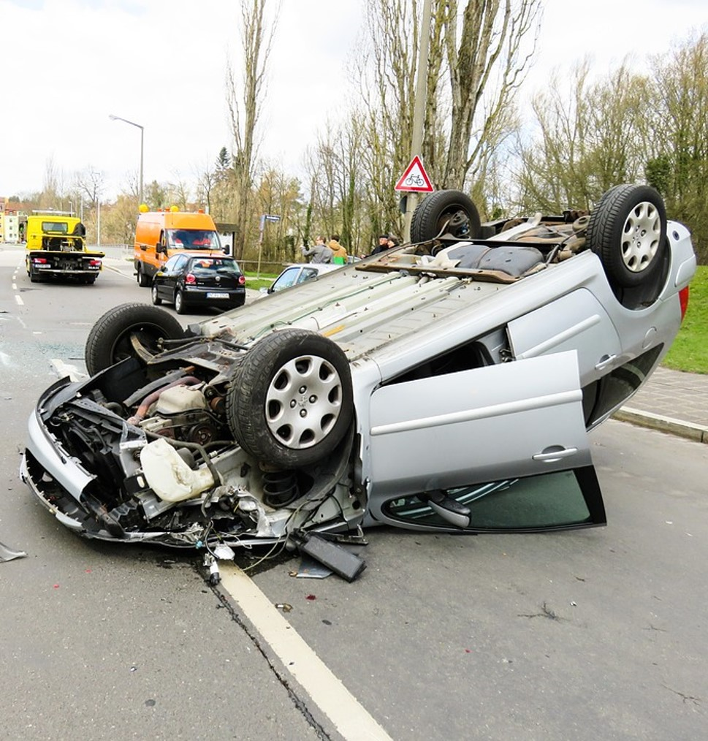
Accident Safety Final Project
Jeffrey Baglioni DS 504
https://github.com/jefbags/DS504
Sample Web App
Notes:
OUTLINE
complete with a clear motivation,
full description with examples
careful evaluation of the effectiveness of the solution
detailed description of your data set
code (in GitHub) of your system
key technologies used
experimental charts
sample runs
detailed analysis of the results.

Slide 2
“Don’t learn safety by accident.”
- Unknown

Slide 3
Project Overview & Goals

Slide 4
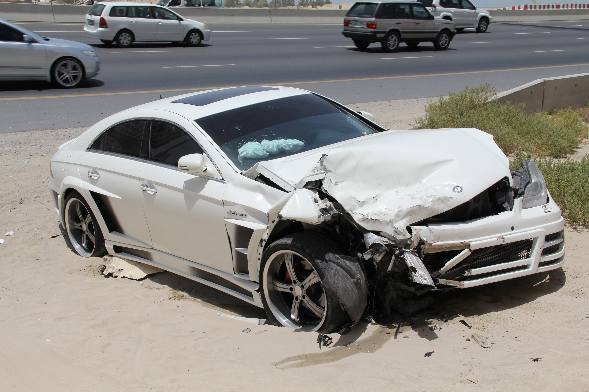
Purpose: Car Accident Analysis
Driving is the single most dangerous activity adults engage in on a daily basis.
What can we learn from sever car accident to make us safer?
Can we analyze accident data to tell about the factorsthat contribute most to the severe accidents?
If we can identify these, can they be useful to governments, public safety groups and civic planners to help make everyone safer?

Slide 5


Project Goals
Analyze all pre-crash variables related to car severe accidents in the US over a period of 3 years
Determine if there statistically significant factors which contribute to a very severe or fatal accident versus those that are not.
Modeled these factors into an algorithm that can be articulated and/or reused independently to identify risk conditions and improve driving safety.

Slide 6

Benefits
The following benefits may be realized by better understanding accident factors:
Automobile insurance providers may use it to calculate more accurate and equitable premium rates that reward drivers who are truly less dangerous.
Driving/navigation applications could incorporate the algorithm to warn drivers in real time when certain conditions are aligning that present an increased and immediate safety risk.
Sensors that measure driver or car behavior (such as high speed, erratic movements) could be used to provide warnings to the driver, or passengers
Drivers could be educated on more specific factors that might be dangerous under specific conditions
Car manufacturers could be more aware of specific vehicle issues under certain road conditions

Slide 7

Data Source
Data will collected from a publicly available data provided by the National Highway Traffic Safety Administration (NHTSA) (link), downloaded in bulk from the FTP site*.
Sampled years will be from 2016-2018. These dates were chosen because the datasets prior to this are less consistent and comprehensive, and no data after 2018 is available.
Accident case number will be used to tie data from NHTSA database together. Date, vehicle make/model, and personal characteristics of the driver, including age, DUI, level of distraction will be assessed.
For the purposes of this project, the NHTSA is the primary sources of data
*Please note that more may be incorporated later, from the NHTSA or other sources

Slide 8

Data Source
NHTSA Fatality Analysis Reporting System (FARS) (link): data on a census of traffic crashes within the 50 States, the District of Columbia, and Puerto Rico which resulted in the death of a vehicle occupant or a nonoccupant within 30 days of the crash. Data goes back to 1975.
NHTSA Crash Report Sampling System (CRSS) (link): a sample of police-reported crashes involving all types of motor vehicles, pedestrians, and cyclists, ranging from property-damage-only crashes to those that result in fatalities. Please note that GES (General Estimate System) (link) was the predecessor of this database, with data going back to 1988. Because of it’s broader and richer features, CRSS was used to develop the algorithms for this project

Slide 9
Exploratory Data Analysis
A review of fatal car crashes from the FARS database* was used to get a sense of some of that factors related to severe accidents. The following are primary conclusions. Please see the Appendix for complete charts and results.
Lighting conditions were typically clear and crashes occurred during the daytime
Speeding was not a factor in the majority of cases
The accidents were generally caused by a car hitting another car
The majority of drivers were male, between 25-54 years of age
10% were related to distracted drivers
34% involved some amount of driving under the influence of alcohol
*https://www.nhtsa.gov/crash-data-systems/fatality-analysis-reporting-system

Slide 10
Data Modeling

Slide 11
Data Modeling - overview
All data code stored online in Githib:
https://github.com/jefbags/DS504
Complete datasets from 2016-2018 CRSS reports
All relevant pre-crash related fields initially incorporated into one Pandas dataframe, see next slide
Shape of the data:
149871 accidents
28 features encoded into 360 columns
18655 severe accidents (as defined on slide 13)
Train/Test Split: 33% Test, 66% Train, testing on the Accident Severity column

Slide 12

Technology Used
Python 3.6 was the primary coding language in concert with the following primary libraries:
Data modeling
Numpy, Pandas, Jupyter Notebook, Scikit, Seaborn, Matplotlib, Shap, Scikit-plot, Google COLAB
Webapp
Flask, AWS Elastic Beanstalk

Slide 13
Features (X)
Data from the CRSS database has been assessed for any PRE-CRASH factors that could contribute to an accident. Key data fields in this database include:
Fatalities Crash Type Date/Time Holidays Location – Region Distracted Driver | Driver age Road Conditions Pedestrian involvement Weather Conditions Motorcycle involvement Vehicle Make/Model | Road Conditions Road Type Protective Gear Used Drug/Alcohol Use Lighting Conditions Drowsy Driver
*Please see Appendix A for the complete CRSS data map

Slide 14
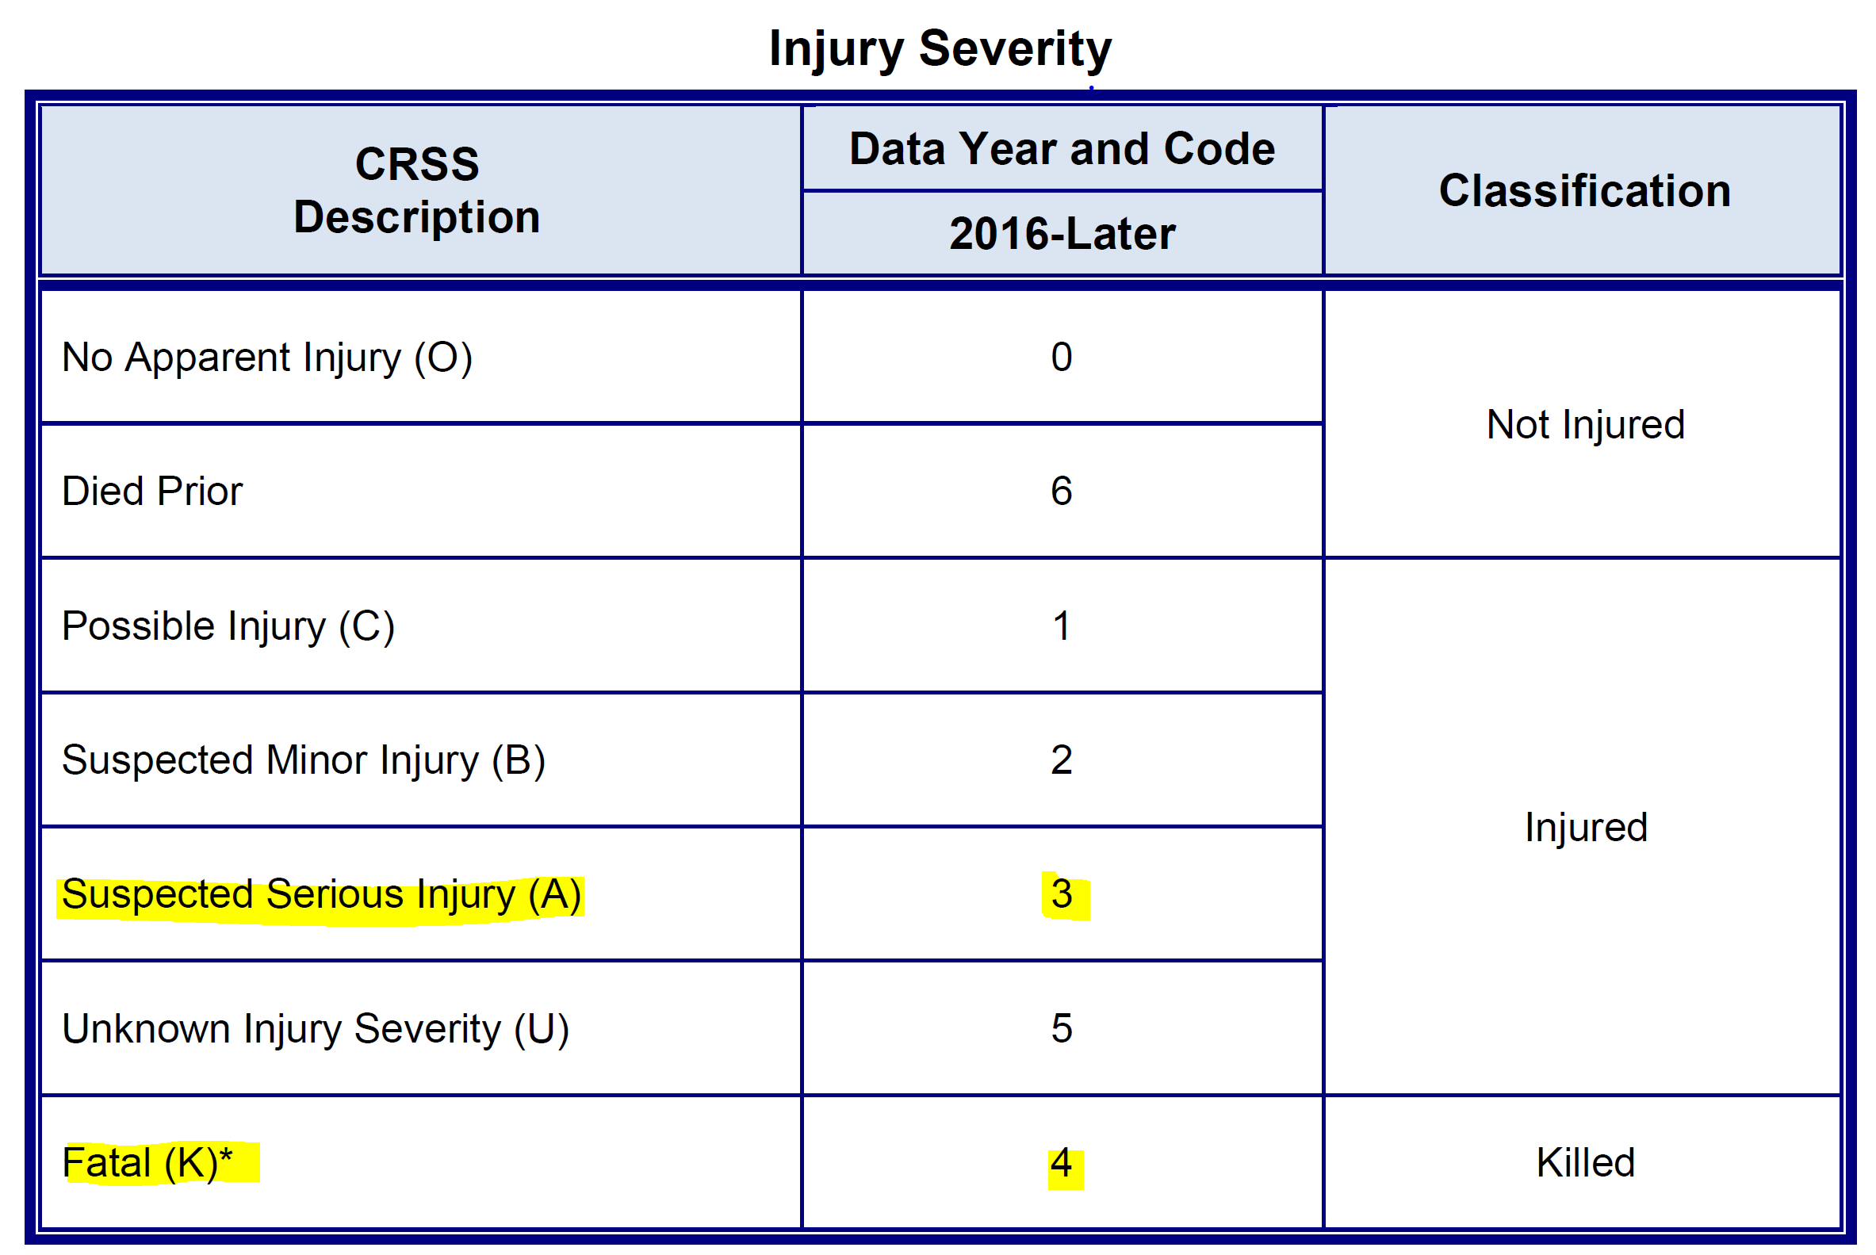
Prediction (y)
The purpose of the model will be to predict whether an accident will be “severe” or not given a combination of its features.
Utilized existing crash severity rating field, that utilizes a scale from 0 to 5
The two most severe ratings, 3 and 4 were encoded into a new field: ‘SEV_ACC’
Any accident rated with a 3 or 4 is encoded with a 1 in SEV_ACC, otherwise it is a 0
*Please see Appendix A for the complete CRSS data map

Slide 15
Prediction (y)
The purpose of the model will be to predict whether an accident will be “severe” or not given a combination of its features.
Utilized existing crash severity rating field, that utilizes a scale from 0 to 5
The two most severe ratings, 3 and 4 were encoded into a new field: ‘SEV_ACC’
Any accident rated with a 3 or 4 is encoded with a 1 in SEV_ACC, otherwise it is a 0
*Please see Appendix A for the complete CRSS data map

Slide 16
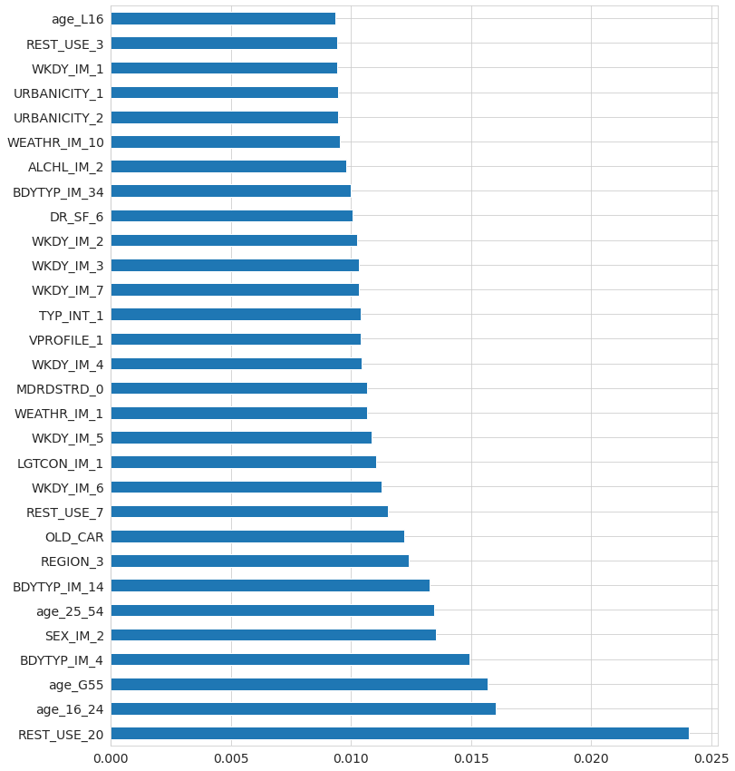
Refinement Part 1: Top 30 Features Importance – Gini
To determine which features have the greatest impact on a sever accident, 28 pre-crash factors were assessed by encoding into 360 columns to assess their relation to the outcome using Random Forest Classifier Feature Importance. These included:
Age/Sex | Day of week
Seatbelt Use | City/Rural
Weather | Alcohol Use
Vehicle Body Type | Month
Crash circumstances (construction, school etc.) | Road Conditions (Grade, Curve etc.)
Intersection Type | Lighting
Drive Distractions

Slide 17
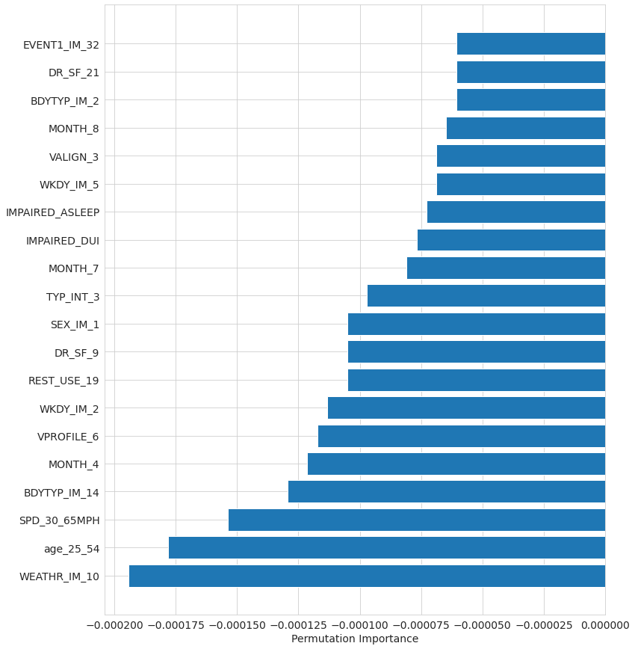
Refinement Part 2: Top 20 Permutation Based Feature Importance
Additionally, Random Forest Classifier’s Permutation Based Feature Importance was calculated to confirm previous results. The outcome was similar, with the addition of the following features:
- First Harmful Event (what caused the crash?)
- Speed
- Impaired driver (DUI and Asleep)

Slide 18
Refinement Part 3: Features Reduction - Removed
Based on the features importance analysis, the following were removed from the consideration from the dataset for the following reasons.
Feature | Rationale
Age, Sex, Month, Day of the Week | Although significant, these are not interesting features, and generally speaking are not related to a behavior or other action that could be changed.
First Harmful Event | This is not pre-crash information (too predictive)
Region | While interesting, it is not really relevant to improving driving safety

Slide 19
Results

Slide 20
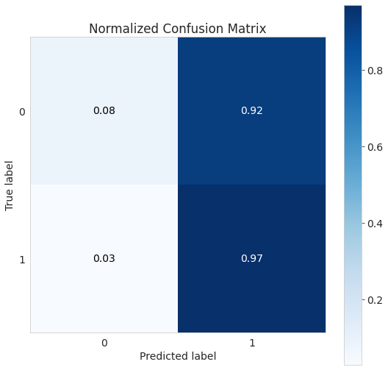
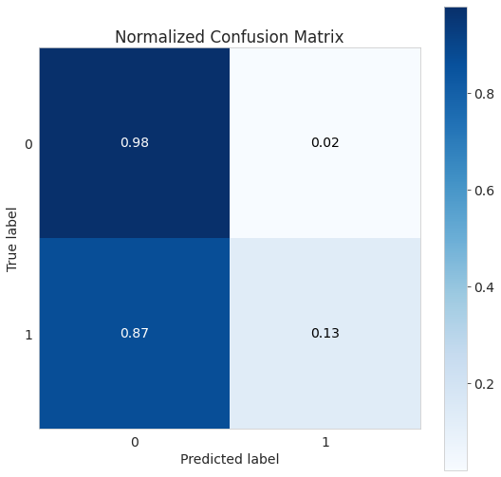

Results – Model Scores
Three models were tested using the identified features: Naïve Bayes, Random Forest Classifier and Gradient Booster Classifier. Naïve Bayes performed notably less well.
Naïve Bayes : | Random Forest Classifier: | Gradient Booster Classifier:
Accuracy Score: 0.19659104694892637 | Accuracy Score: 0.8799385337053661 | Accuracy Score: 0.8798576570019006
=== Mean AUC Score === 0.5798661476620639 | === Mean AUC Score === 0.7830277291071646 | === Mean AUC Score === 0.7799693795145941

Slide 21
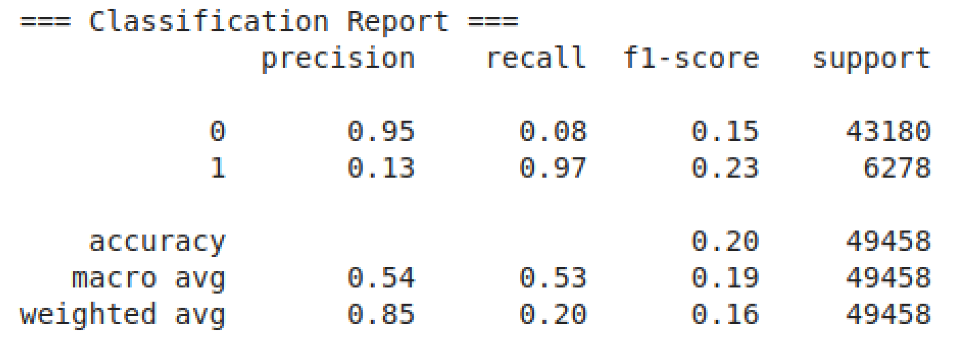
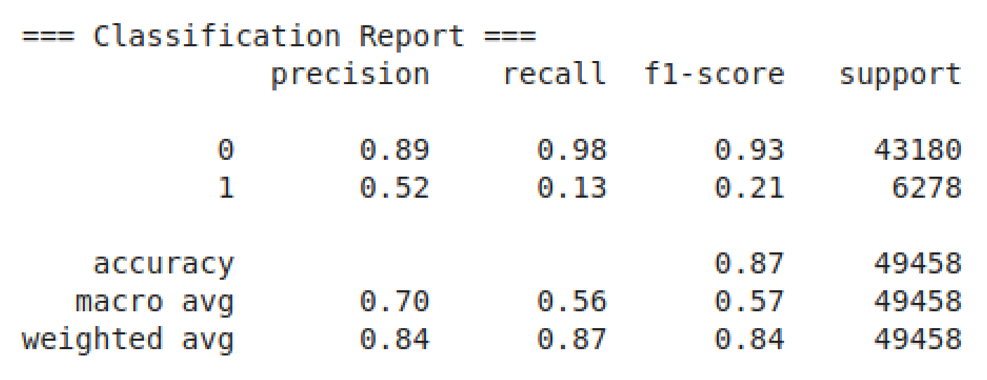
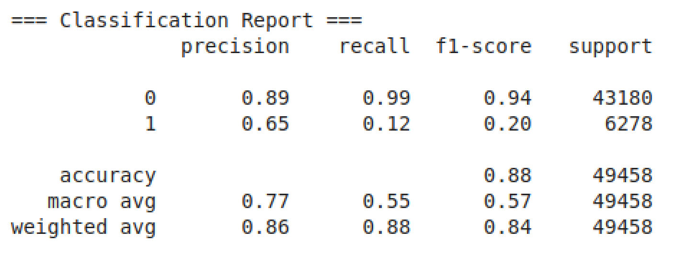
Results – Model Scores
Naïve Bayes :
Random Forest Classifier:
Gradient Booster Classifier:

Slide 22
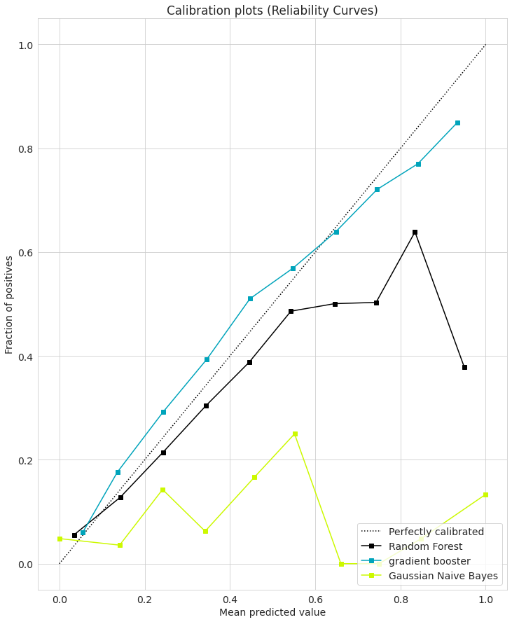
Model Perf: Calibration/ Reliability Curves

Slide 23
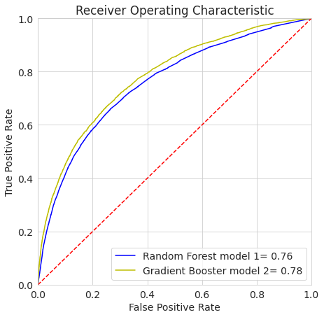
Model Perf: AUC-ROC Curve

Slide 24
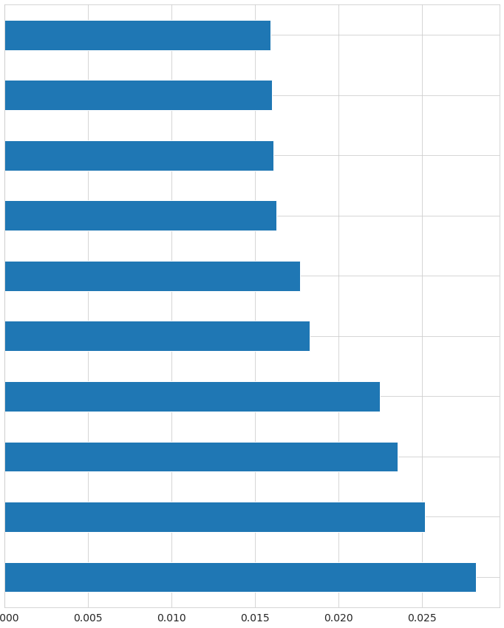
Final Results: Top 10 Key Features
No intersection
Clear weather
A severe accident is most likely to have the following characteristics.
Based on these, we concluded that the results of this analysis are inconclusive at this time, and need further refinement and analysis.
The one take-away however is that the number one most likely characteristic is lack of seatbelt. This reinforces guidance that a seatbelt can save lives, and prevent injury.
Level Ground
Daylight
Light Pickup
Not distracted
Pre-2010 vehicle
Compact SUV
4 door sedan
No seatbelt used

Slide 25

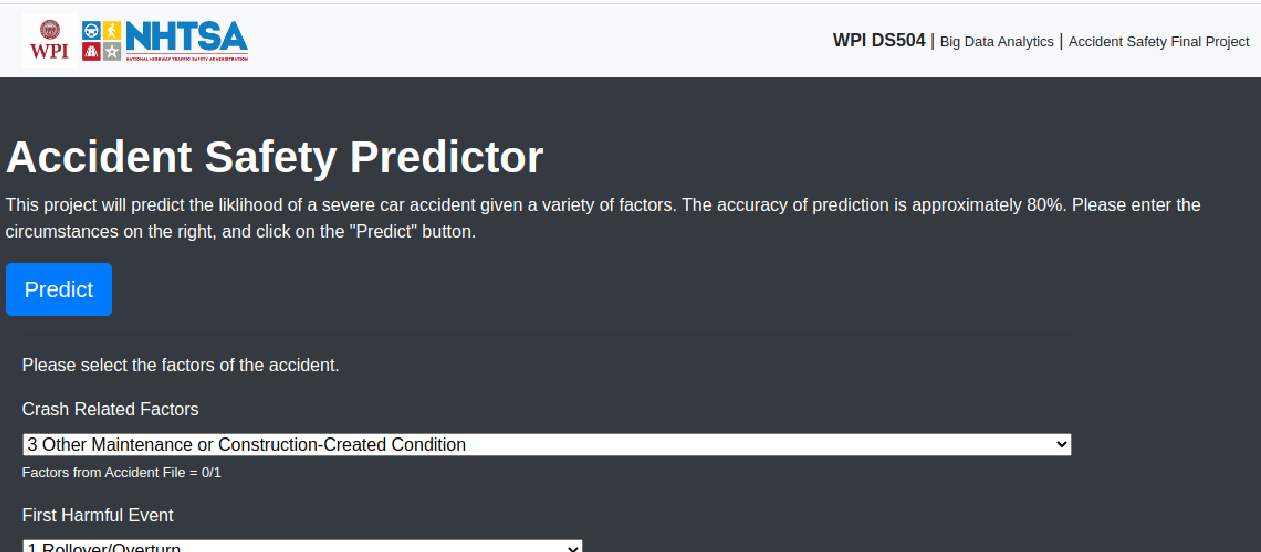
Web application
A simple Flask web app was created to help test the model and output. The web app uses the Gradient Booster algorithm to classifier the likelihood of a severe accident given the factors.
The app is hosted on AWS using Elastic Beanstalk:

Slide 26
Appendices

Slide 27
Results – Model Scores
Naïve Bayes : | Random Forest Classifier: | Gradient Booster Classifier:
=== Confusion Matrix === [[ 3632 39548] [ 187 6091]] | === Confusion Matrix === [[42394 786] [ 5440 838]] | === Confusion Matrix === [[42779 401] [ 5541 737]]
=== All AUC Scores === [0.56141076 0.64080751 0.59449129 0.54919863 0.57286261 0.55053552 0.57057201 0.56593731 0.55970792 0.63313791] | === All AUC Scores === [0.75735106 0.75770958 0.74640722 0.77185293 0.74394967 0.75619542 0.7552925 0.75383968 0.75657995 0.75511267] | === All AUC Scores === [0.78666903 0.78032098 0.77393187 0.78451059 0.76576999 0.78283067 0.78013605 0.77774818 0.78518102 0.78259543]

Slide 28
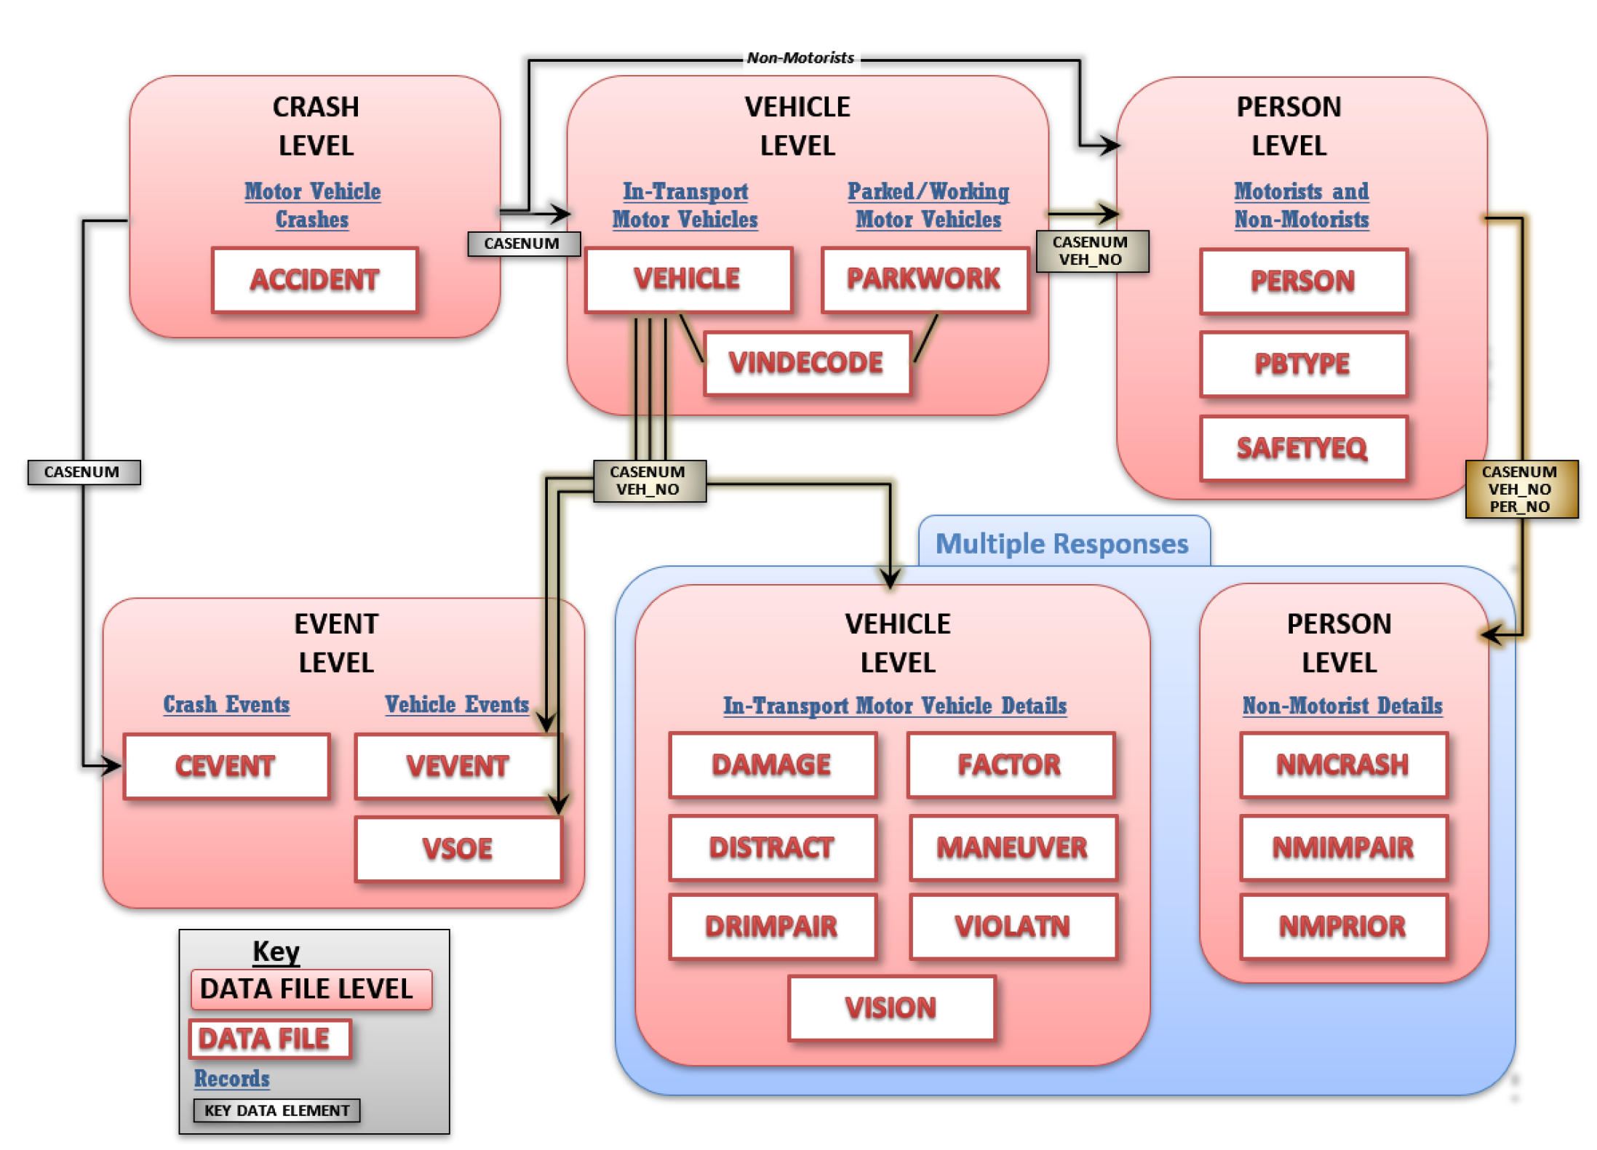
Appendix – data map

Slide 29
Appendix – EDA Charts

Slide 30
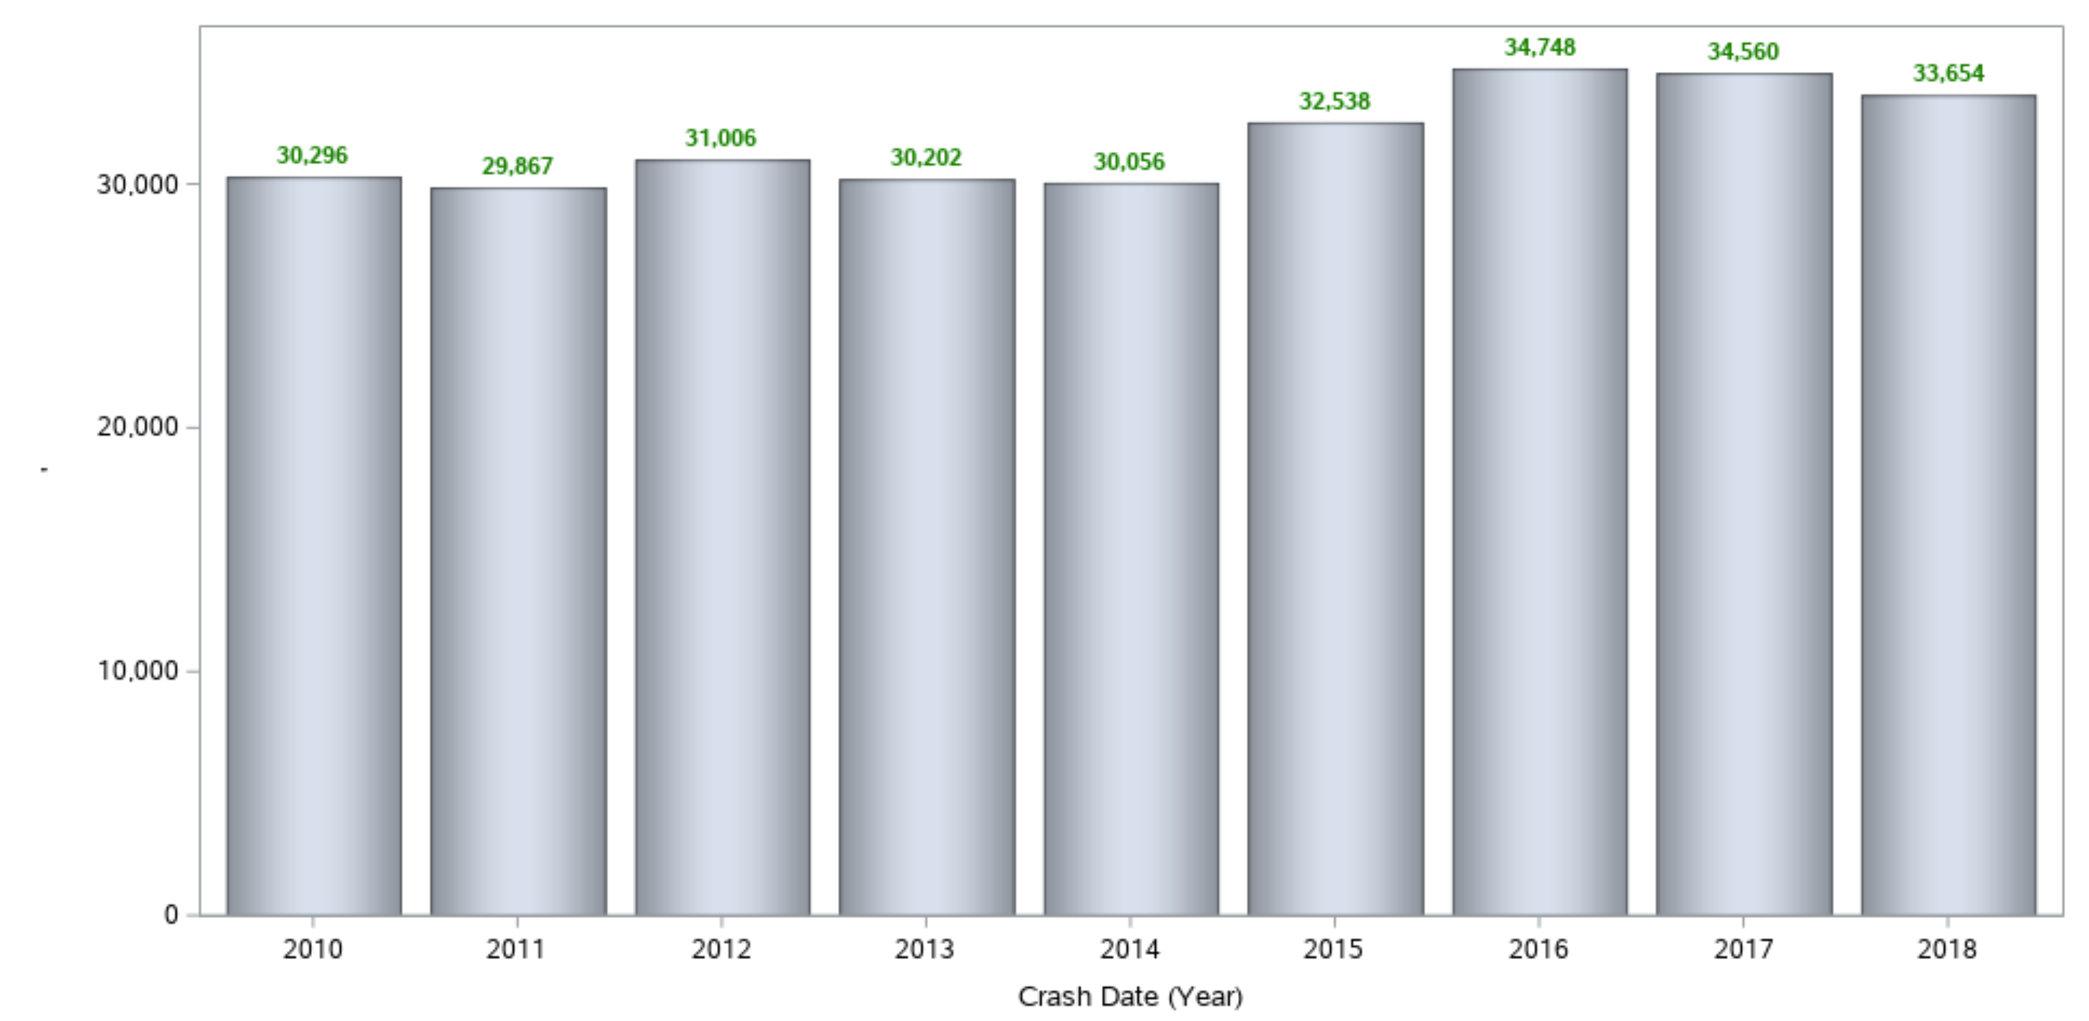
Total Fatal Crashes/Year

Slide 31
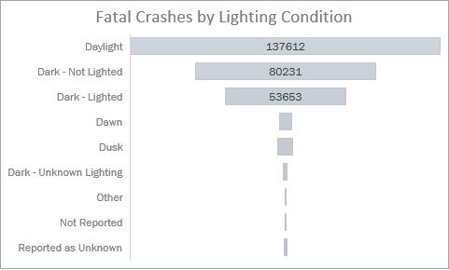
Lighting/weather conditions are usually clear
Two thirds (66%) of all crashes have occurred in daylight or lighted conditions, with the other third in the dark.
Of those, the vast majority have occurred in clear, ‘No Adverse Atmospheric Conditions/Clear/Cloudy’
WEATHER SEEMS TO NOT BE A BIG FACTOR IN FATAL CAR CRASHES

Slide 32
Speeding is not a factor
Surprisingly, excessive speed is not usually involved fatal car crashes in the past eight years.

Slide 33
‘First Harmful Events’ – Biggest damage producing factors
By FAR the biggest cause of fatal car accidents are ‘Motor Vehicle In-Transport’ – i.e. a car hitting another car. Other factors include rollovers, trees and pedestrians.

Slide 34
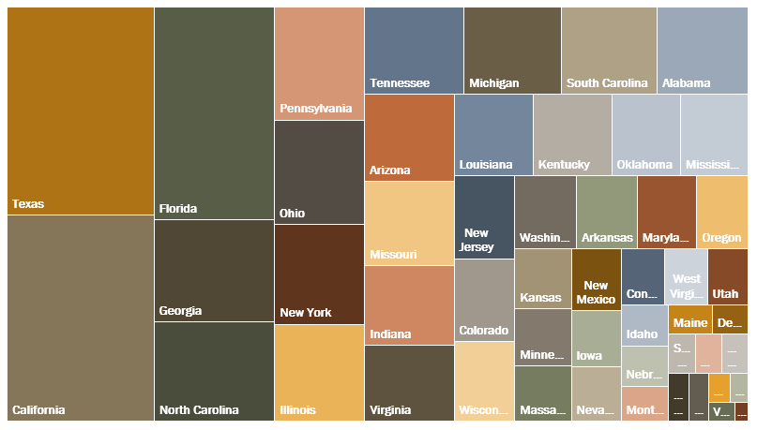
Where are most of the crashes?

Slide 35
Driving under the influence causes deaths…
34% of all crashes involved some amount of alcohol (greater then .01)
29% of all crashes were with drivers who were over the legal limit of of .08 g/dL or higher which indicates alcohol-impaired driving.
The majority of alcohol related crashes were with men, by a factor of almost 2

Slide 36
EMT response times – data is poor
In the overwhelming number of cases, the EMS response time is not known.
The key take-away is that given the limited reporting here, this data may not be comprehensive enough to use in further analysis.
Other response time were fairly uniformly spread across any number of minutes, up to one hour.

Slide 37
What about age or gender?

Slide 38
Involving drowsy or distracted drivers?
3%
10%
The number of crashes involving drowsy drivers
The number of crashes involving distracted drivers
The crashes attributed to distracted drivers is smaller than expected. It’s still three times more deadly than being tired though, and that is significant.

